Slide 1


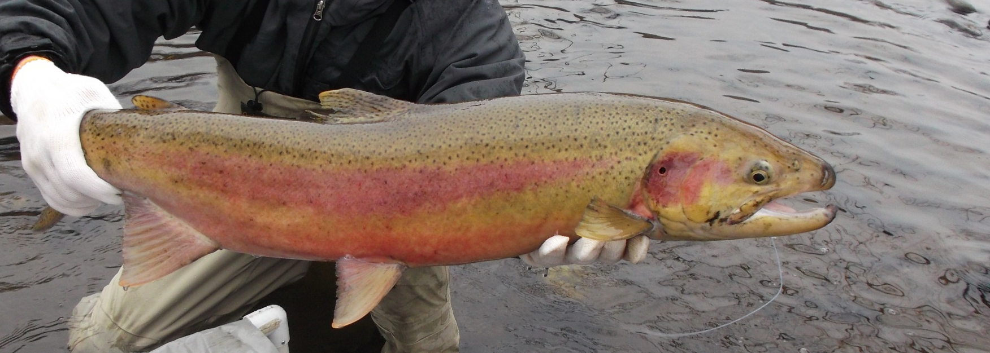

Dispersion of South Fork Clearwater River Steelhead Spawners
Presented by:
Peter Cleary
Nez Perce Tribe Department of
Fisheries Resources Management
Notes:
Good afternoon, I am Peter Cleary and I will be presenting the results of a radio telemetry study of South Fork Clearwater River steelhead in north central Idaho. This study is funded by the Bonneville Power Administration. The data I’ll be presenting was collected from 2013 to 2017.

Slide 2
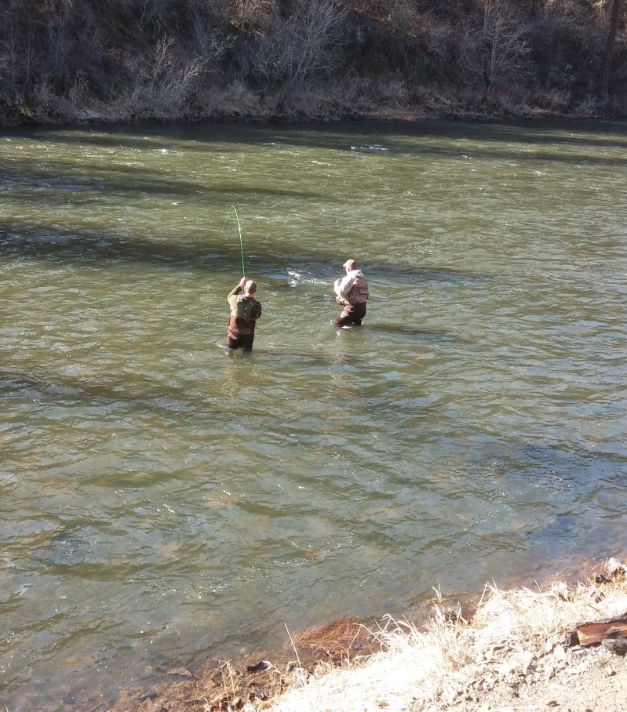
Purpose
Determine if natural and hatchery steelhead spawn in the same areas
Notes:
The purpose of the radio telemetry study was to determine if natural and hatchery steelhead spawn in the same areas in the South Fork Clearwater River. If spawning occurred in different areas it could account for differences in productivity of natural and hatchery spawners.

Slide 3
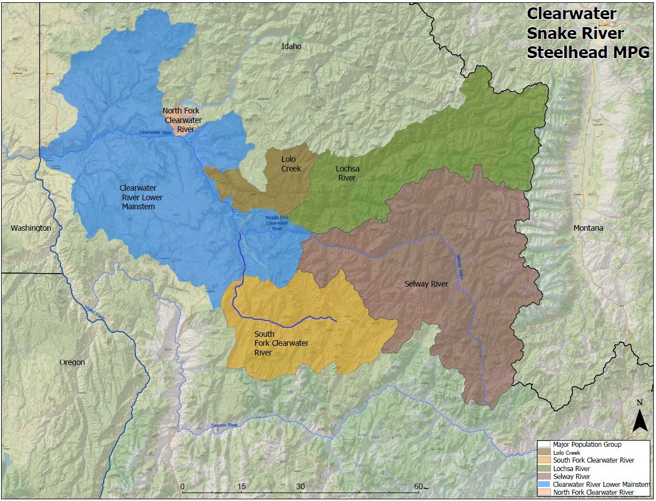
Notes:
South Fork Clearwater steelhead are part of the Clearwater River Steelhead Major Population Group of Snake River summer steelhead. This major population group has six population areas. The western end of the MGP begins at the confluence of the Clearwater River at Idaho’s western border. The eastern end is the Bitterroot Mountain range at the Montana border. Steelhead in the lower portion of the South Fork Clearwater River are considered to be part of the Lower Mainstem population with predominantly A-Run type steelhead. Steelhead in the upper portion of the South Fork Clearwater River are considered to be part of the South Fork Clearwater River population with predominantly B-Run type steelhead.

Slide 4
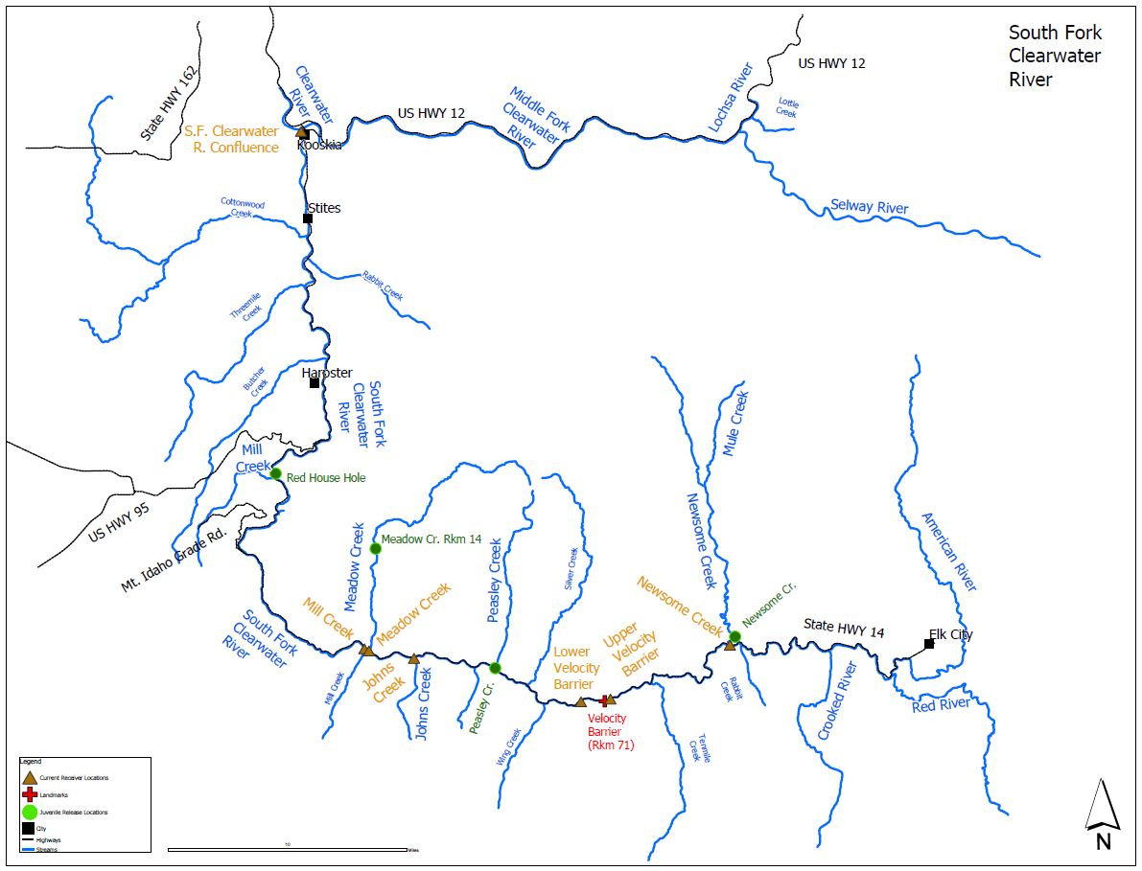
Notes:
This study treated steelhead in the lower and upper portions of the South Fork Clearwater River as one population. The study area for the radio telemetry study was the entire South Fork Clearwater River.
Elevation at Kooskia: 1,293 ft or 394 m
Elevation at Elk City: 4,006 ft or 1,220 m
Important juvenile release sites to note on this map are:
Red House Hole at rkm 31
Meadow Creek at rkm 53
Peasley Creek at rkm 62 and
Newsome Creek at rkm 84
Also important to note is the presence of a series of rapids at rkm 71 that’s been commonly referred to the last couple of years as the Velocity Barrier that I’ll discuss later in this presentation. Landmarks at this location include highway mile marker 28 near a place in the road referred to as the Hanging Rock.

Slide 5
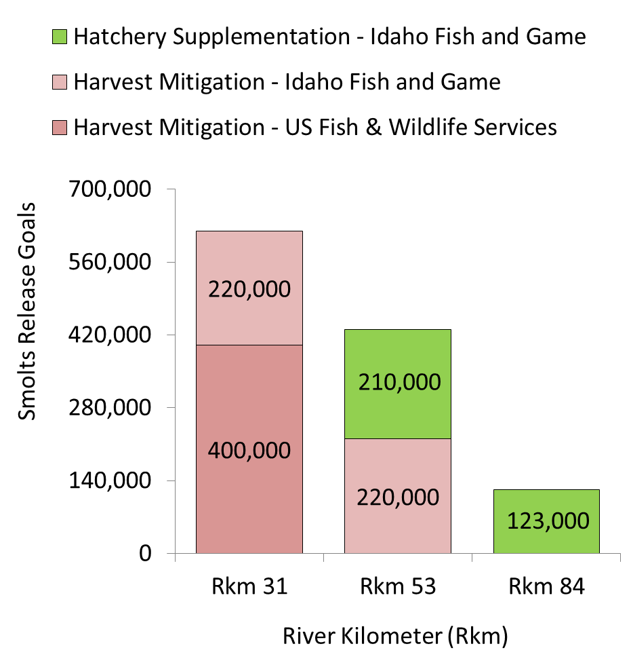
South Fork Clearwater Steelhead Hatchery Programs and Goals
Annual Production Goals: 1,173,000 smolts
Harvest Mitigation
840,000 smolts released
Mostly clipped (Conventional)
Hatchery Supplementation
330,000 smolts released
Unclipped (Supplementation)
Smolts released at three or more locations
Notes:
Before I talk about the study I feel it’s important to talk about the hatchery programs in the South Fork Clearwater River because it’s generally accepted that steelhead will return as adults to the areas they were released as juveniles.
The annual production goal for juvenile hatchery steelhead released into the South Fork Clearwater River is close to 1.2 million smolts per year.
Juvenile smolts are produced for two purposes; harvest mitigation and hatchery supplementation.
Juvenile smolts produced for harvest mitigaton generally have an adipose fin clip and referred to in this presentation as Conventional.
Juvenile smolts produced for hatchery supplementation are unclipped.

Slide 6
Management Questions
Are hatchery origin spawners using the same spawning areas as natural origin spawners?
Are Conventional and Supplementation hatchery spawners using the same spawning areas?
Are Supplementation hatchery spawners more likely to than Conventional spawners to access spawning habitat upstream of Rkm 84?
Notes:
When the radio telemetry study began in 2013 managers wanted answers to three questions: (read questions).

Slide 7
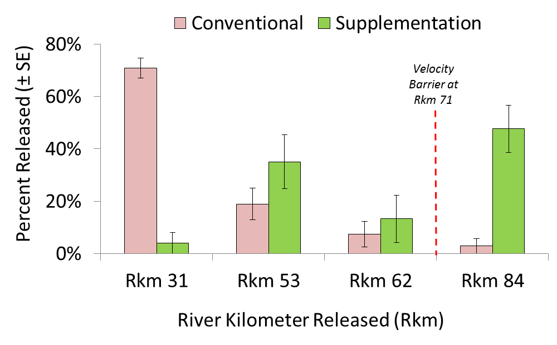
The Percent of Juvenile Hatchery Steelhead Released by River Kilometer & Program (2008-2016)
Notes:
If we look at the percent of fish released from 2008 to 2016 we see that the majority of the conventional smolts were released at the Red House Hole at Rkm 31 and about half of the supplemental, or unclipped steelhead, were released at Newsome Creek at Rkm 84. And a mixture of Conventional and Supplemental smolts were released in between at Meadow Creek at Rkm 53 and Peasley Creek at Rkm 62.

Slide 8
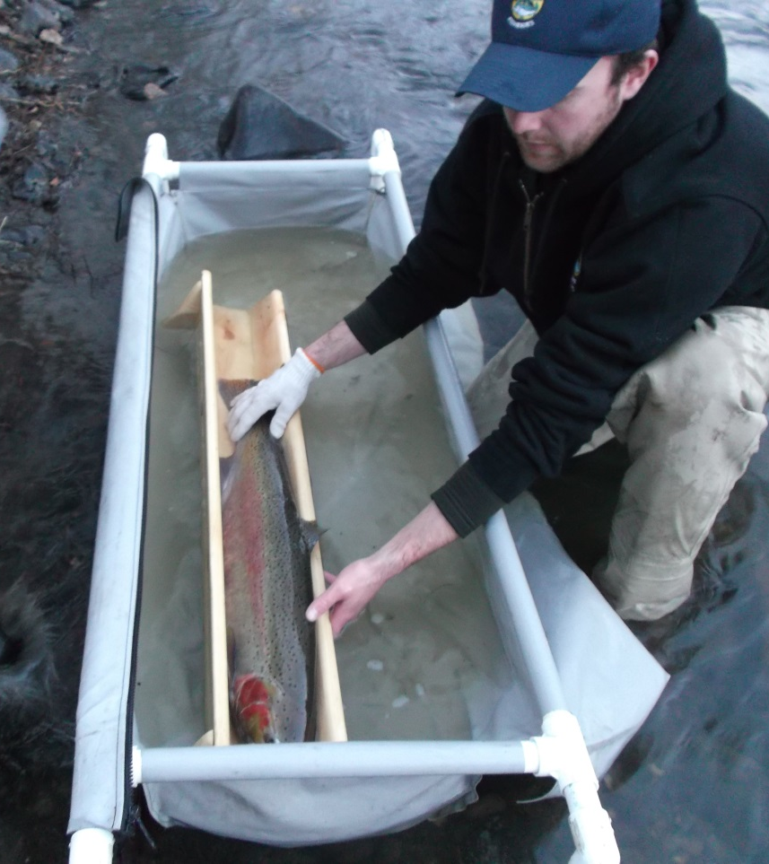
Methodology
Annually radio tag 120 SFCWR adult steelhead
Conventional (n = 40)
Supplementation (n = 40)
Natural (n = 40)
Track to furthest upstream location using fixed and mobile receivers
Convert waypoints to closest river kilometer
Notes:
Spawning distribution was determined by radio tagging a total of 120 steelhead each year in three groups of 40.
The fish were tracked using fixed sites and mobile telemetry receivers mounted in a truck driven along the South Fork Clearwater River.
The data was then reviewed to determine the furthest upstream location of a radio tag.
The waypoints were then matched to the nearest river kilometer for the analysis of data.

Slide 9
Methodology (continued)
Target PIT tagged adult returns for radio tagging at Lower Granite Dam in the fall
Identify adults Bonneville Dam
Identify the hatchery program and release location
Capture targeted adults at Lower Granite Dam
Radio tag angle caught fish in the spring
Use marks and tags to determine hatchery program
Use genetic analysis to verify origin
Notes:
Steelhead were radio tagged at both Lower Granite Dam during the fall and in the South Fork Clearwater River during the spring. Radio tagging at Lower Granite Dam was possible because a large number of returning adults had been marked with PIT tags as juveniles and could be identified and diverted into the adult trap at Lower Granite Dam during the fall. If tagging goals were not met at Lower Granite Dam during the fall, they were continued in the spring in the South Fork Clearwater River.

Slide 10
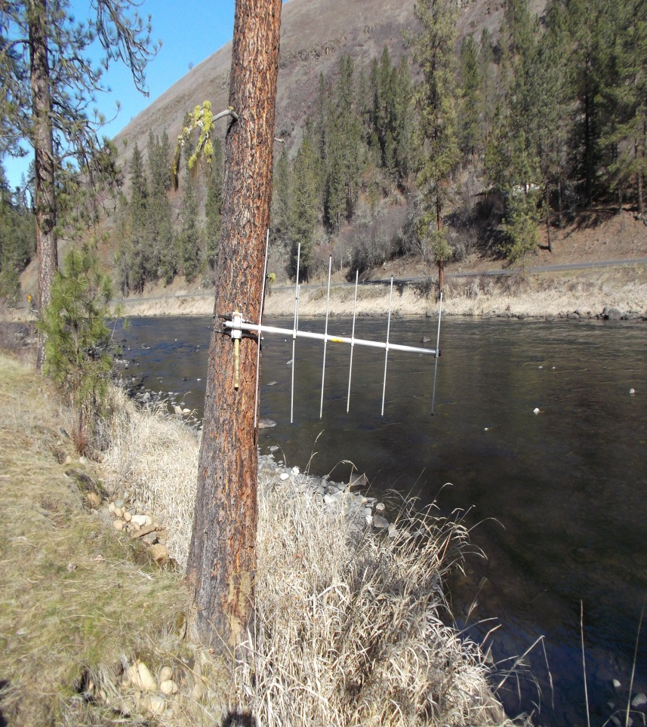
Methodology (continued)
Direction of movement was determined by Yagi directional antennas
Up to three antennas used at fixed sites
Downstream
Upstream
Into tributary
Notes:
Yagi directional antenna's were used at stationary fixed sites. Sites had 2 to 3 antennas to determine directions of movement.

Slide 11
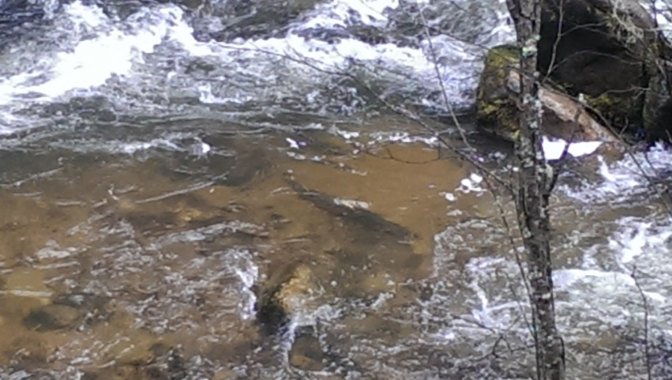
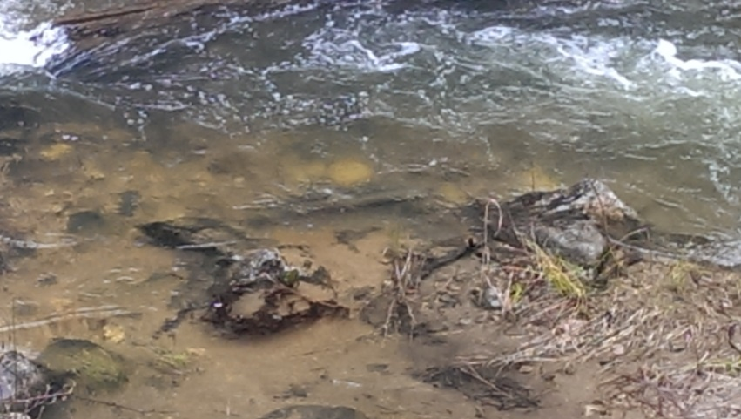
Methodology (continued)
Spawn timing was determined from the dates associated with furthest upstream detections
Photos by Johnny Wright
Notes:
Yagi directional antenna's were used at stationary fixed sites. Sites had 2 to 3 antennas to determine directions of movement.

Slide 12
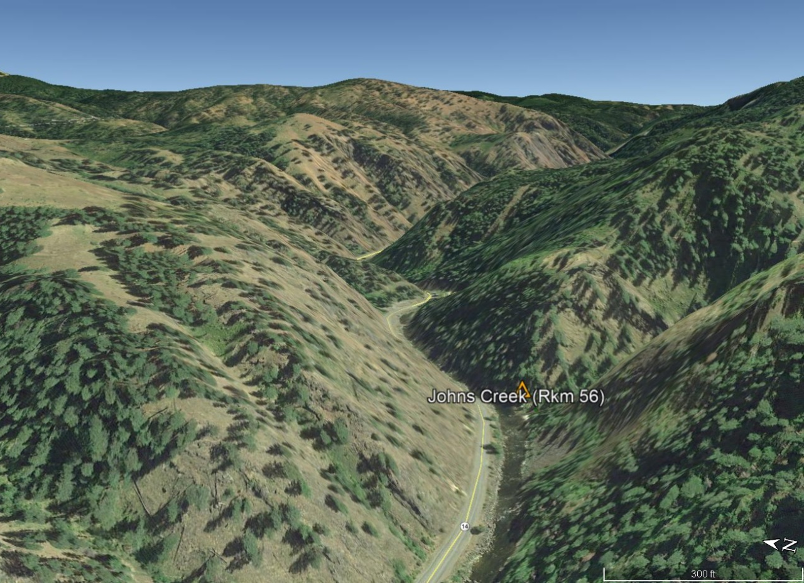
Topography
Image Courtesy of Google Earth
Notes:
Steep terrain in the study area limited data collection to the road next to the river because it wasn’t possible to track in many tributaries without the additional expense of fixed wing aircraft. The orange triangle shown in this image represents the receiver at Johns Creek were the elevation is about 730 m. The ridgetops in this area are just over 1,000 m.

Slide 13
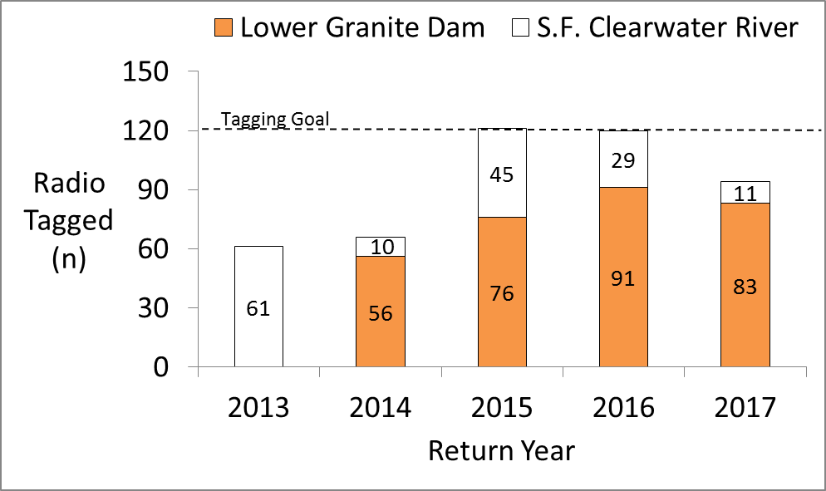
Radio Tagging Accomplishments (2013-2017)
Fish Radio Tagged at Lower Granite Dam by Idaho Fish and Game
Notes:
Over a five year period the project met its goal of 120 radio tagged adults twice, once in 2015 and again in 2016, with the majority of steelhead radio tagged at Lower Granite Dam.

Slide 14
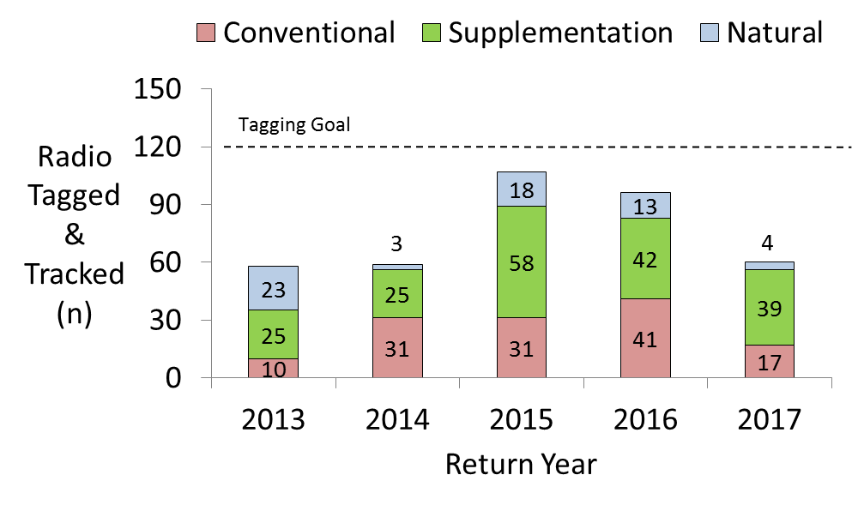
Tracking Accomplishments (2013 – 2017)
Notes:
Tagging goals for natural origin fish were not reached in any year. Not all fish radio tagged were successfully tracked. Some fish were known to have been harvested during the study while others may have regurgitated their radio tags.
Also tagging goals for supplemental fish were overshot because a number of fish tagged in the SFCWR were assumed to be wild at tagging but PBT genetic analysis later showed they were unmarked hatchery adult steelhead.

Slide 15
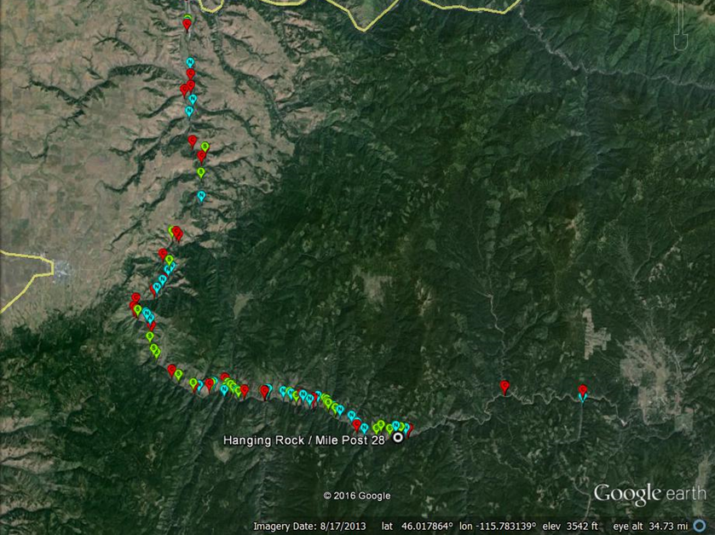
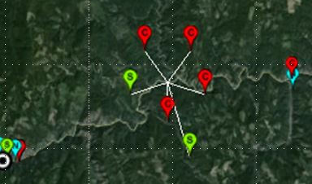
Example of Spawning Locations (2014)
Notes:
A simple but limited way to look a the results for any one year is to map waypoints in Google Earth. This data shows the furthest upstream location detected in 2014. The red dots represent Conventional hatchery steelhead, the green dots represent the Supplementation hatchery steelhead, and the blue dots represent natural origin steelhead. Notice that multiple detections at a single way point can occur but may appear as one way point on the map.

Slide 16
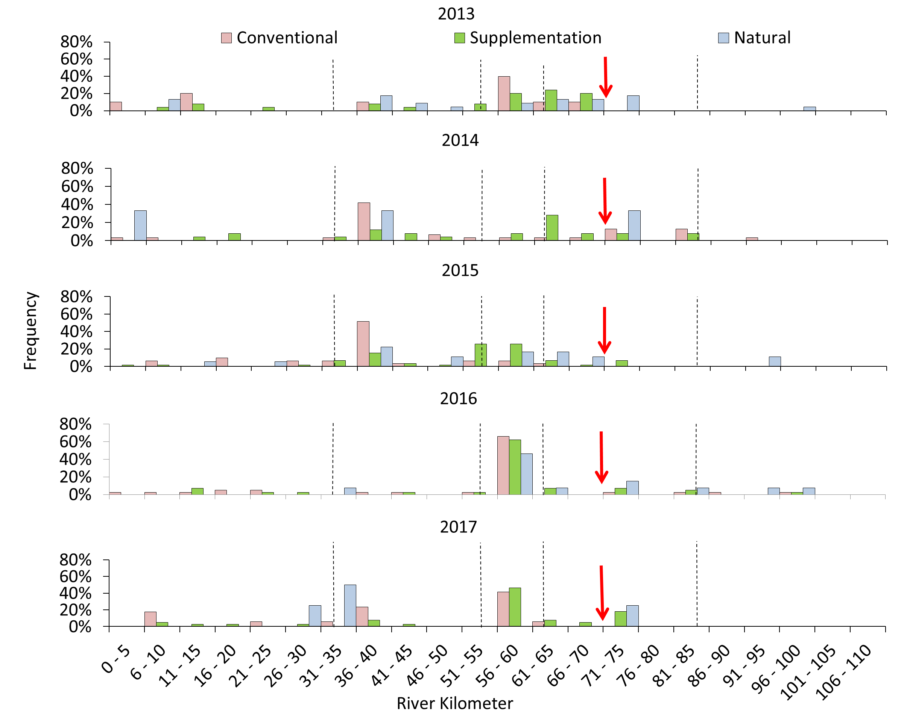
Notes:
A more objective way to look at the data is shown in these frequency plots where the data is plotted by river kilometer. The dashed lines in the plots represent juvenile release locations. The data is still a bit difficult to view because the scale of spawning is large and there is a large amount of variation in annual spawning distribution. However, there are two patterns in the data that are worth noting:
1) Spawning locations tend to clump up near juvenile release locations, and
2) Few fish are spawning past river kilometer 71

Slide 17
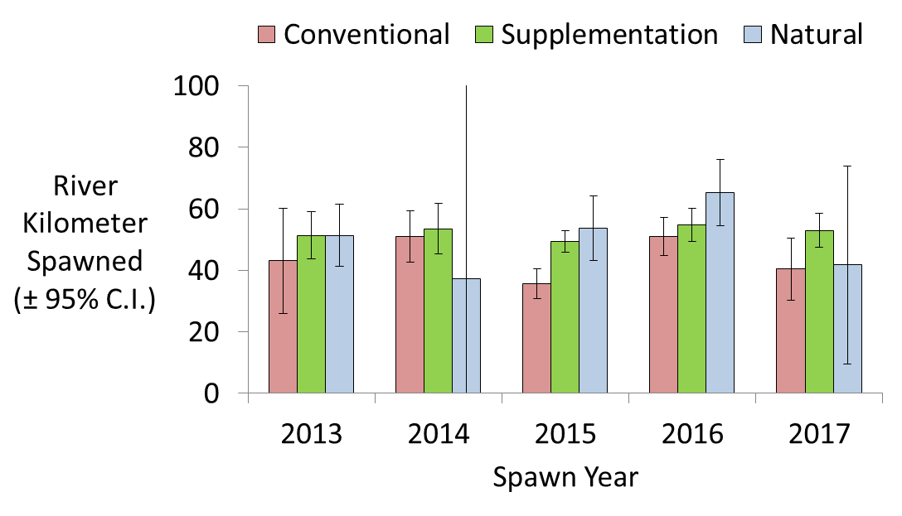
Comparison of Mean River Kilometer Spawned (2013 - 2017)
Notes:
Aside from the patterns just noted in the annual spawning distribution the overlapping confidence intervals show there was no statistical difference in the spawning locations chosen by Conventional, Supplementation, or natural origin steelhead in any given year.

Slide 18
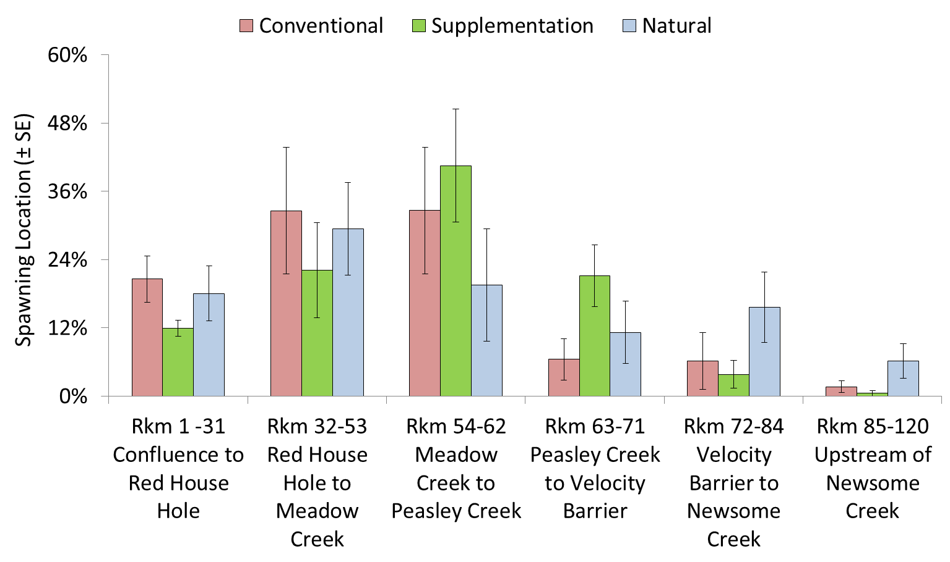
Inter-Annual Mean Spawning Locations by River Sections (2013 - 2017)
Notes:
If we look at the spawning distribution by major river sections instead of just by river kilometers we can see that the majority of the Conventional hatchery adults spawn between Rkm 32 and 62. And a greater percent of natural origin adults spawn upstream of Rkm 71.

Slide 19
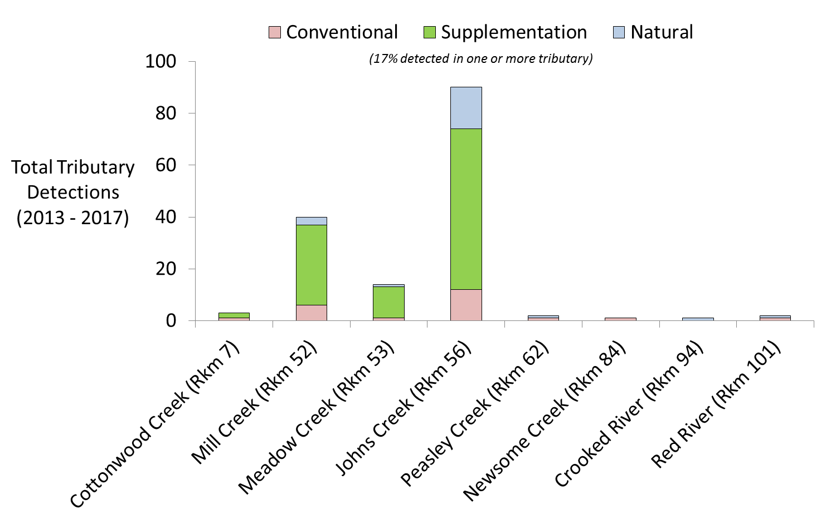
Detections in Tributaries (2013 - 2017)
Notes:
Use of tributaries for spawning was documented for some, but not all, tributaries because we were not able to conduct radio telemetry surveys in all tributaries. Seventeen percent of the fish detected in tributaries were detected in one or more tributary the study. The majority of the fish detected were from the Supplementation group. However, for the tributaries that we did monitor we found that the tributaries most used were located upstream of the Red House Hole at Rkm 31 and downstream of the Peasley Creek. In a few limited cases were able to visually identify redds. But we believe spawning in the South Fork Clearwater River is occurring in the river as well as it’s tributaries.

Slide 20
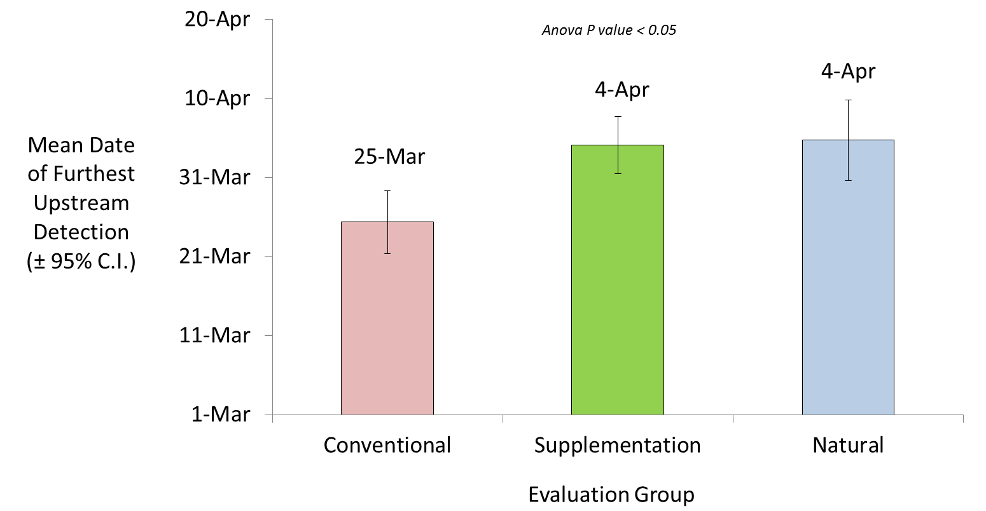
Spawn Timing (2013 - 2017)
Notes:
Another aspect of spawning that examined by the study was spawn timing. Statistically hatchery conventional spawners had an earlier mean spawn timing that the Supplementation hatchery spawners. The ten day difference may be biologically insignificant and the time of tagging could have influenced results because Conventional tagging goals were usually the first met at Lower Granite Dam during the fall. Natural origin fish were tended to be tagged later in the spring. Additionally some of the fish we assumed to be natural origin at the time of tagging were later reassigned to the Supplemental group during the analysis of the data after genetic test results were received.

Slide 21
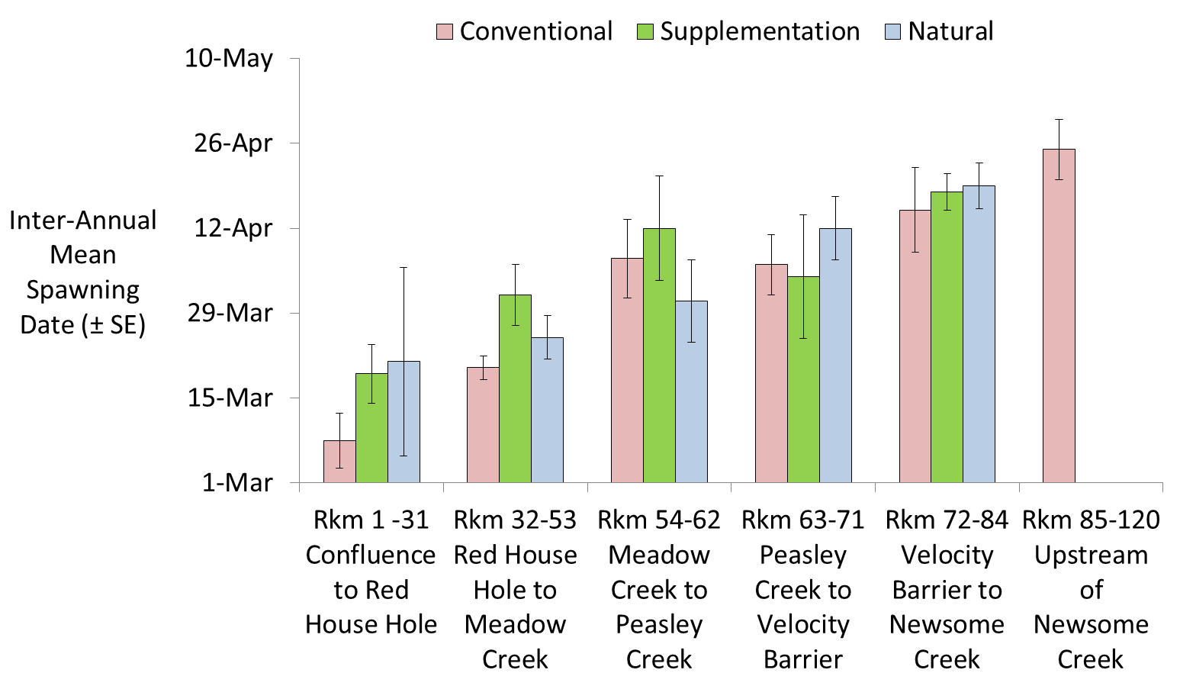
Inter-Annual Mean Spawn Timing by River Sections (2013 - 2017)
Notes:
But if we look at the inter-annual mean spawning timing by major river section instead of the overall mean a pattern emerges that shows spawn timing is earliest at the lower elevations and latest at highest elevations.

Slide 22
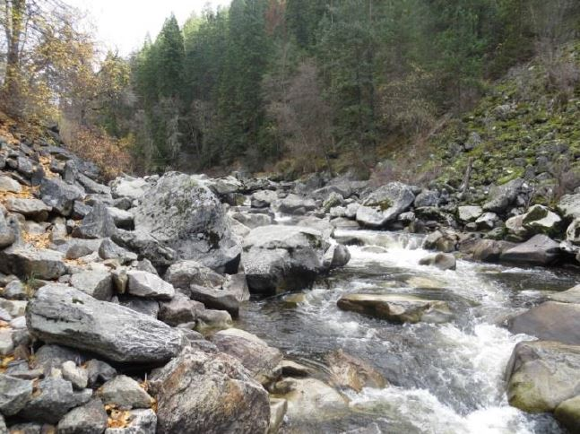
Mile Post 28 (A.K.A The Velocity Barrier)
Notes:
I’ve mentioned the velocity barrier earlier times today. This is what it looks like looking upstream. It is a section of river approximately 3 rkm long with high velocity rapids.

Slide 23
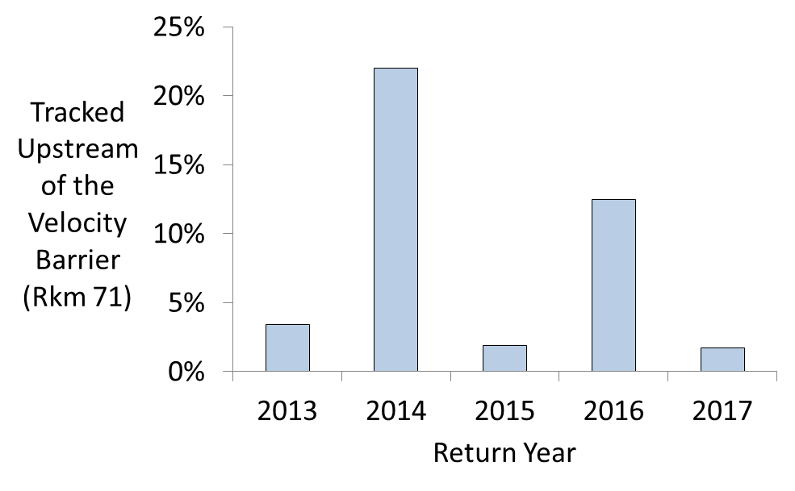
Percent of Radio Tagged Steelhead Detected Upstream of River Kilometer 71 (2013 - 2017)
Notes:
The percent of the radio tagged fish tracked upstream from rkm 71 has ranged from less than 2% to more than 20%. However, it’s not known if all radio tagged fish intended to migrate upstream of the barrier because:
1) the juvenile release location was not known for all radio tagged adults and
2) not all fish detected near rkm 71 were released upstream of rkm 71 as juveniles.

Slide 24
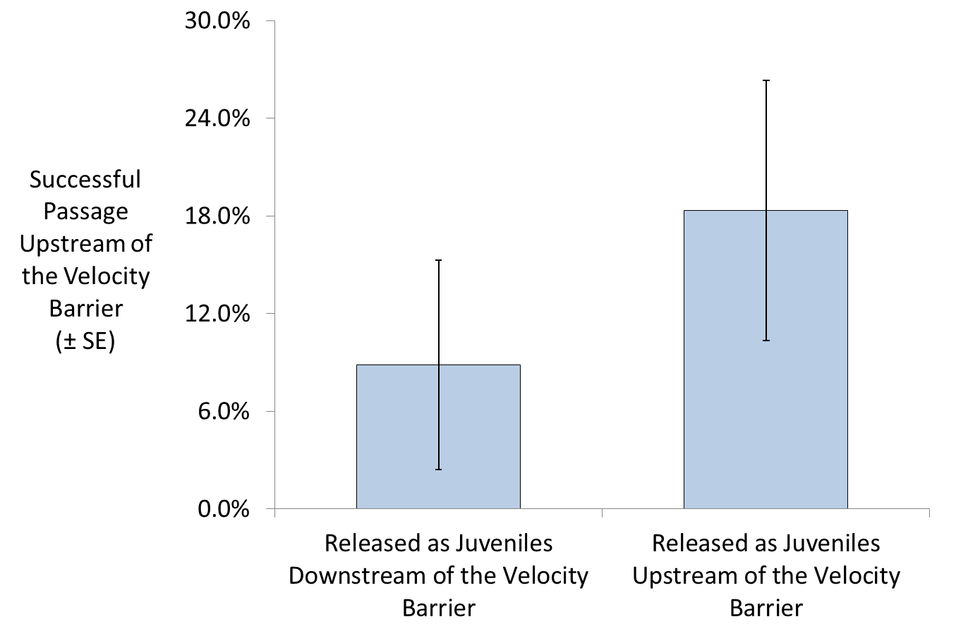
Inter-Annual Percent Passaging the Velocity Barrier (2013 - 2017)
Notes:
But when we look at just the radio tagged fish with a known juvenile release location we see that a higher percent of steelhead released as juveniles above the velocity barrier were successful at passing the velocity barrier than those released as juveniles downstream of the velocity barrier.

Slide 25
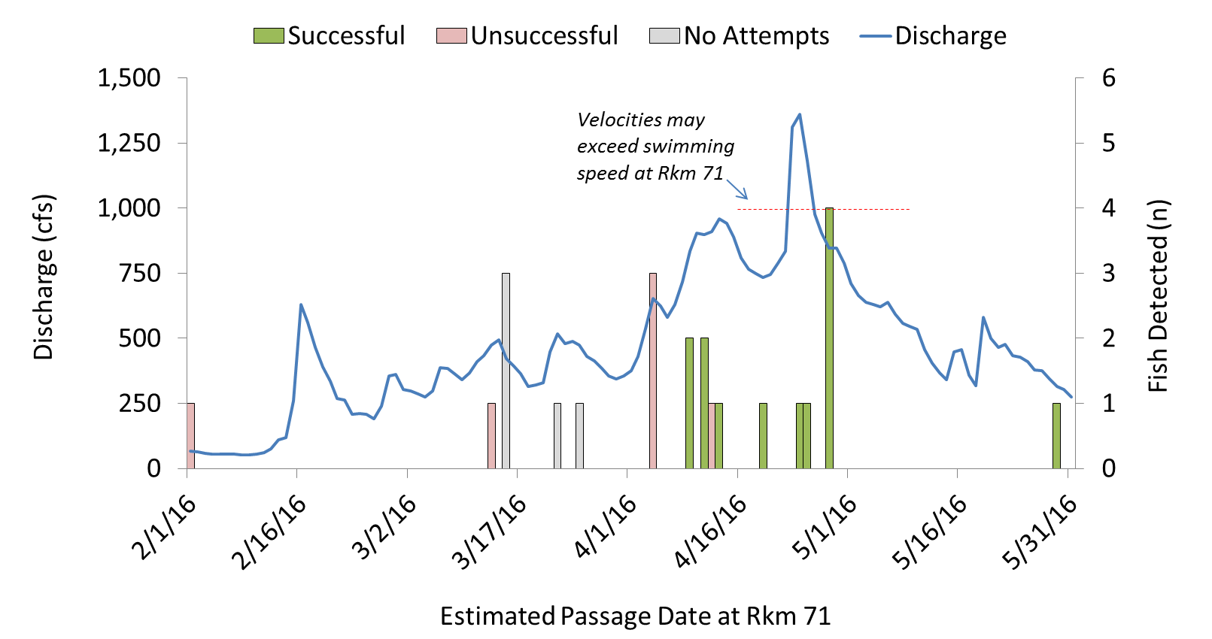
When is the Velocity Barrier a Barrier?
* NPT data/Cramer Fish Sciences (2016)
Notes:
So when is the velocity barrier a barriers. Cramer associates modeled stream flow through the velocity barrier in 2016 and paired the data with movement of radio tagged fish through the barrier. They determined that around 1000 cfs the velocities in the river would be faster than the theoretical swimming speed of a 90 cm steelhead. So the velocity barrier is a barrier around 1000 cfs.

Slide 26
Answers to Management Questions
Are hatchery origin spawners using the same spawning areas as natural origin spawners?
Yes – The majority of all spawning occurs in a 30 Rkm section between Red House Hole and Peasley Creek
Are Conventional and Supplementation hatchery spawners using the same spawning areas?
Yes - Same Reason as above
Notes:
Restate the three management questions and give short answers

Slide 27
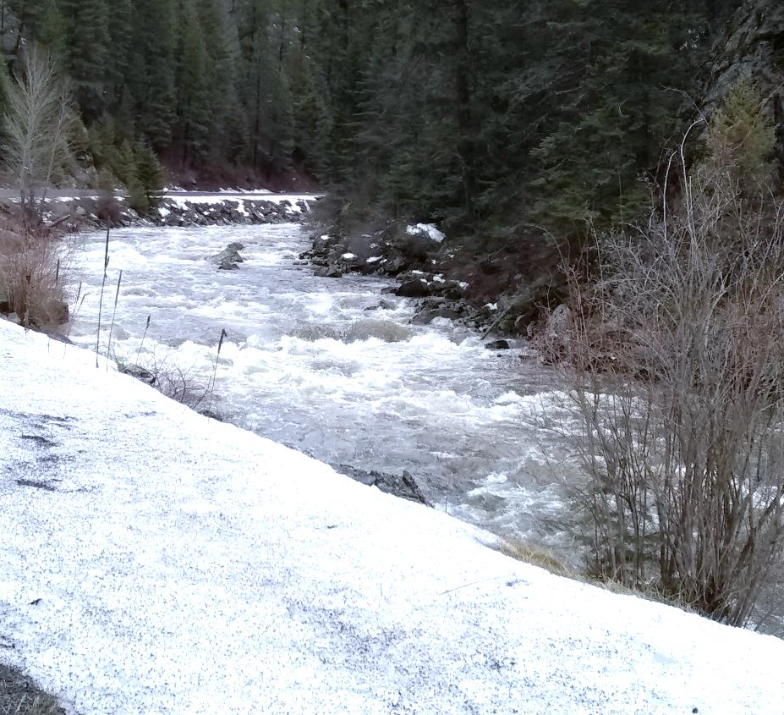
Answers to Management Questions
Are Supplementation hatchery spawners more likely to than Conventional spawners to access spawning habitat upstream of Rkm 84?
No – There appears to be a partial migration barrier at Rkm 71
Additional Conclusion
Downstream of Mile Post 28 (February) –
Photo by Peter Cleary
Notes:
[state answer] &
Additionally, steelhead tend to return to where they were released. If managers desire more steelhead above the velocity barrier there are several options but the simplest may be to release more fish upstream of Rkm 71.

Slide 28
Acknowledgements
NOAA Fisheries
Idaho Fish and Game
NPT BPA Project # 200003600
Pacific States Marine Fisheries Commission
Notes:
Before I end today I’d like to acknowledge our co-managers at NOAA Fisheries and IDFG for assistance trapping and radio tagging adult steelhead at Lower Granite Dam and in the South Fork Clearwater River. I’d also like to acknowledge BPA funding for the NPT Watershed project that funded the study contracted to Crammer Associates. And I’d like to give a special thanks to the PSMFC for their help with the separation by code trapping system and covering the cost of my registration for this event.

Slide 29
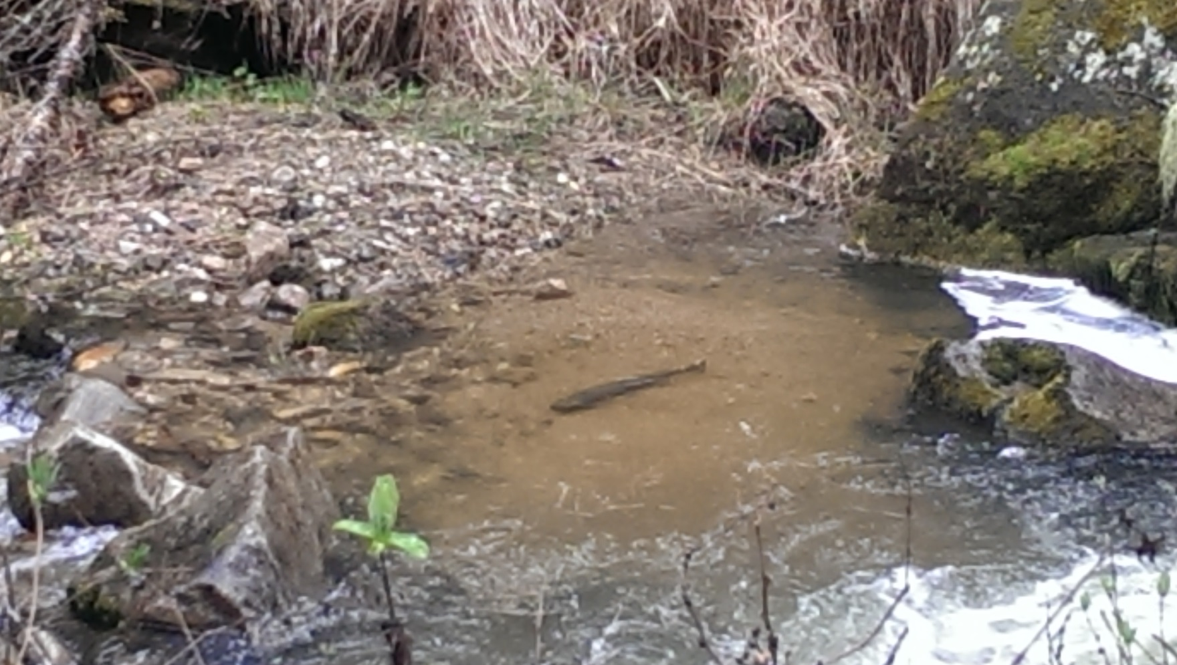
Questions & Discussion
Mill Creek 2016 – Photo by Johnny Wright
Notes:
And with that I’ll end this presentation and welcome any questions you might have.

